Slide 1
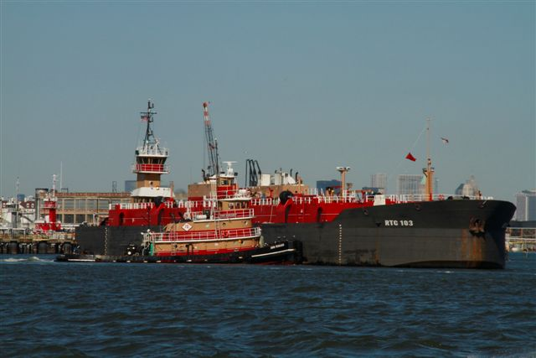
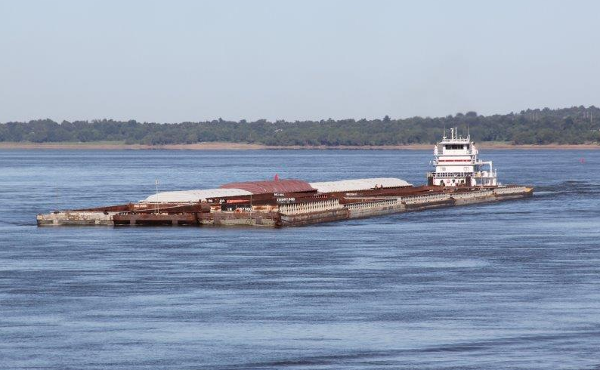
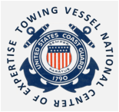
Subchapter M
Towing Vessel National Center of Expertise

Slide 2
Definition and Applicability
Towing Vessel means a Commercial Vessel engaged in or intending to engage in the service of pulling, pushing or hauling alongside
Applicable to all U.S. flag towing vessels except:
  Assistance towing
  Towing recreational vessels in limited areas or for salvage
  Workboat operating exclusively within a worksite
  Seagoing towing vessel subject to Subchapter I
  Vessels inspected under other subchapters that perform occasional towing
  Public vessels
  Propulsion units
  Vessels < 26 ft in length unless pushing, pulling, or hauling a barge that is carrying oil or hazardous material in bulk

Slide 3
Compliance Dates
Most existing towing vessels must continue to comply with 46 CFR subchapter C until July 20, 2018 unless a COI is issued earlier.
  One exception...Watertight & weathertight requirements detailed in 46 CFR 144.320 are effective July 20, 2016
Four-year phase in of COI requirements
  25%, 50%, 75%, 100%
  If company only has 1 Towing Vessel, must have COI by July 20, 2020
Two Deferred Equipment Requirements NLT 5 years after COI date
  Pilothouse Alerter System
  Towing Machinery
New Towing Vessel must obtain a COI before it enters service
  Keel laid or major conversion initiated on or after July 20, 2017

Slide 4
46 CFR Subchapter M Timeline
July 20
2016
Subchapter M regulations effective , but most of Parts 140-144 delayed for 2 years or after vessel is issued a COI.
July 20
2017
Vessels built or initiating a major conversion are considered a “new towing vessel” (46 CFR 136.110) and are subject to part 140-144 requirements.
July 20
2018
Parts 140-144 implemented, with exception of Health and Safety Plan, Pilothouse Alerter System, Towing Machinery requirements.
All vessels must comply with watertight and weathertight requirements of 46 CFR 144.320
July 22
2019
July 20
2020
July 19
2021
Year 7 to
Year 11
25% of a company’s fleet must have a valid COI except for companies with only 1 existing towing vessel.
50% of a company’s fleet must have a valid COI.
Companies with only 1 existing towing vessel must obtain a COI
July 19
2022
75% of a company’s fleet must have a valid COI.
100% of a company’s fleet must have a valid COI.
June 20
2016
Subchapter M Published
5 years after issuance of initial COI, existing vessels comply with 46 CFR 143.450 (Pilothouse Alerter System) and 46 CFR 143.460 (Towing Machinery requirements).
Year 11
Subchapter M Implementation is Complete.
Towing Vessel owner or managing operator must implement a Health & Safety Plan. 46 CFR 140.500

Slide 5
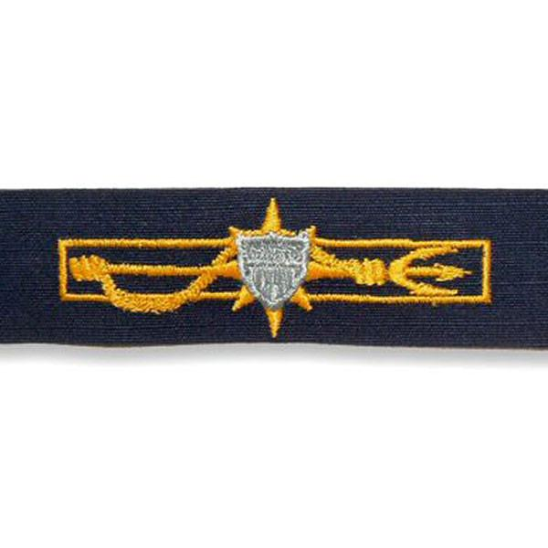
Compliance Options
Policy
Planning
Implementation & Action
Checking & Corrective Action
Management Review
Towing Safety Mgmt System
(TSMS) Option
Coast Guard Option
Changing options requires new COI
Specify Option on COI Application

Slide 6
Benefits of a TSMS
Flexibility
  Can be scaled for company size/type
Accountability
  Establishes responsibility
Fosters Continuous Compliance
Consistency
  Clear, well defined procedures and roles
Documentation
Policy
Planning
Implementation & Action
Checking & Corrective Action
Management Review

Slide 7
Towing Safety Mgmt System (TSMS)
Reviewed and audited by TPO
ISM compliant SMS and other equivalent SMS “existing systems”
Must contain required elements:
  Administration and management organization:
    Management organization:
      Designated person
      Master’s authority
    Audits:
      Procedures for conducting internal and external audits
      Procedures for identifying and correcting non-conformities.
  Personnel:
    Employment procedures
    Training of personnel
  Verification of vessel compliance:
    Maintenance and survey
    Safety, environment, and security
  Compliance with 46 CFR subchapter M

Slide 8
TSMS Survey Programs
External Surveys are conducted by TPO, which can be a Classification Society.
Internal Surveys are conducted by trained personnel with a direct affiliation to the vessel, owner or managing operator. Internal Surveys, or examinations, can be completed in stages over time.
Mix of two (internal topsides, external drydocking, etc)

Slide 9
TSMS Option
Options within the Option
Required for all TSMS Options
Company (Management) | Vessel
External TSMS audit every 5 years by TPO External mid-period TSMS audit by TPO Annual internal management TSMS audits | External TSMS audit every 5 years by TPO CG inspection for certification every 5 years Credit dry dock(s) and ISE(s) *
* Dry docks/ISEs under the internal survey program can be a continuous event scheduled over time 137.315(c)
Company choice (Options) – pick one...or...more...
External Survey Program | Internal Survey Program
Annual external vessel survey by a TPO Survey is a single event within 3 months of the COI date External drydock exam | Annual internal vessel survey Survey can be a continuous event scheduled over time (up to 1 year ) Internal drydock exams over time
Note: A CG accepted existing SMS or a fully compliant ISM SMS can be
used to meet TSMS requirements 138.225

Slide 10
Third Party Organizations
Must be CG approved
TPO’s evaluate TSMS – Issue TSMS Certificates
Conducts Audits & Surveys to demonstrate vessel compliance with Subchapter M
Classification Societies

Slide 11
Initial COI
6 Months Before COI Inspection (If utilizing TSMS)
If TSMS & company complies w/requirements, TPO audits management & vessel*. TPO issues company TSMS Certificate.
3 Months Before COI Inspection
Company schedules initial COI inspection with OCMI.
30 Days Before COI Inspection
Company submits Application for Inspection to OCMI.
TSMS Vessels also submit Objective evidence to OCMI per 136.210 and 137.202.
Initial COI Inspection Conducted by U.S. Coast Guard and a COI is issued.
Company maintains list of vessels under TSMS Certificate.
*Vessels external audit may be conducted 6 months after the COI if the vessel has been owned for less than 6 months

Slide 12
Inspections & Surveys
Inspections & Surveys | CG Option | TSMS Internal Program | TSMS External Program
COI Inspection | CG | COI issued by CG Survey - 137.202 | COI issued by CG Survey - 137.202
Annual | CG | Internal Survey (may be over time) 137.210 | External Survey by TPO w/in 3 months of anniversary date 137.205
Notes :
Internal Survey programs are conducted under the oversight of a TPO.
§ 138.115 TSMS Option - must obtain Towing Safety Management Certificate at least 6 months before COI. (Compliance with ISM Code is compliant w/Sub M. TSMS-related requirements § 138.225)
§ 136.210 & 137.202 TSMS – Provide Objective Evidence of compliance to OCMI - survey
CG Option Recordkeeping – May use any of the following options: Management system, vessel ops manual, towing vessel record or logbook (§ 136.130(c))

Slide 13
TSMS Audit Requirements
 | TSMS Internal Program | TSMS External Program
Vessel Audit | Before Initial COI* & once in 5 by TPO § 138.315 | Before Initial COI* & once in 5 by TPO § 138.315
Management Audit | Internal – Annually § 138.310 By TPO 2 in 5 | Internal – Annually § 138.310 By TPO 2 in 5
Notes: * Vsls owned <6 mos prior to COI may have external vsl audit up to 6 mos after
§ 138.310 Internal mgmt audits annually, within 3 mos of TSMC anniversary date
§ 138.505 (a) External Management audits submitted to TV NCOE
§ 138.505 (b) External Vessel audit reports submitted to OCMI
External/internal audit results kept 5 yrs & avail to CG/Surveyor on request.
Audits of TPOs are submitted to the Towing Vessel NCOE
§ 138.500(a) TV must notify the OCMI 72 hrs prior to external audit.

Slide 14
Drydock/ISE Requirements
.
CG or TSMS w/Loadline | CG or TSMS w/Class | CG Option | TSMS Internal Program | TSMS External Program
By Class 137.320 | By Class 137.322 | By CG 137.302 | Internal Survey 137.315 | By TPO 137.310
Notes:
Per § 137.315 (b) and (d), For internal survey programs, owner must notify OCMI and also the TPO responsible for auditing the TSMS prior to drydocking/ISE
Per § 137.335, a Towing Vessel may be are eligible for UWILD
Per § 137.325 (d) OCMI must be notified when the condition of the vessel may create an unsafe condition. (e) Cognizant OCMI may require owner to provide for the attendance of a TPO surveyor/auditor to assist with verifying the vessel's compliance .

Slide 15
Scopes of Surveys & Inspections
Must comply w/ Subchapter M regardless of option
46 CFR Part 137 - Scopes and conduct of surveys
Inspections and surveys closely resemble one another
CG attendance when desired and available on TSMS vessels

Slide 16
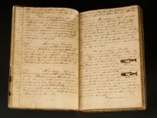
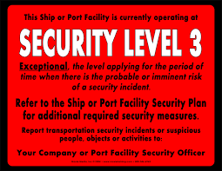
Operations
Personnel
  Safety Orientation, Emergency Duties, Fall Overboard Prevention
Health and Safety Plan
  140.500 Delayed Implementation until July 22, 2019
Reports and Logs
Operational Safety
  Stability, Openings, Tests & Exams, Navigation Safety & Equip
Prevention of Oil & Garbage Pollution
Vessel Security
Towing Gear and Safety

Slide 17
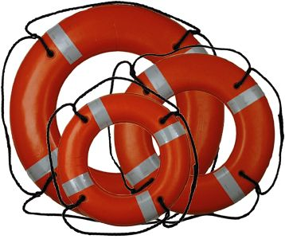
Lifesaving (General)
Subpart A – General
Applicability
Subpart B - General requirements for towing vessels
Lifesaving equipment CG approved
Alternative arrangements or equipment allowed
  Requires CG approval (TPO may approve alternatives for lifejackets, immersion suits and lifebuoys)
Equipment maintained, tested and ready for use at all times
Crew trained on location, operation and use of lifesaving equipment

Slide 18
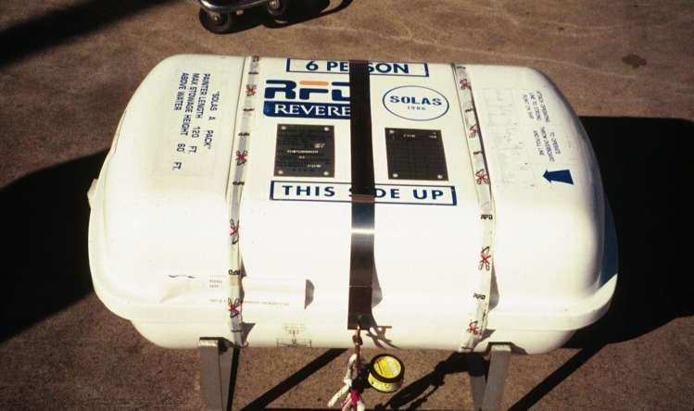
Lifesaving
Subpart C - Lifesaving requirements for towing vessels
Survival craft:
  Carriage based on:
      Area of operation
      Warm/cold water operation
  Stowage, marking, equipment requirements
  Certain vessels may use a skiff as a substitute
At least one appropriately-sized lifejacket w/attachments for each person onboard; more for vessels with berthing.
At least one appropriately-sized immersion suit with attachments for each person onboard if the vessel operates in certain regions
1 to 4 lifebuoys with attachments based on the vessel length

Slide 19
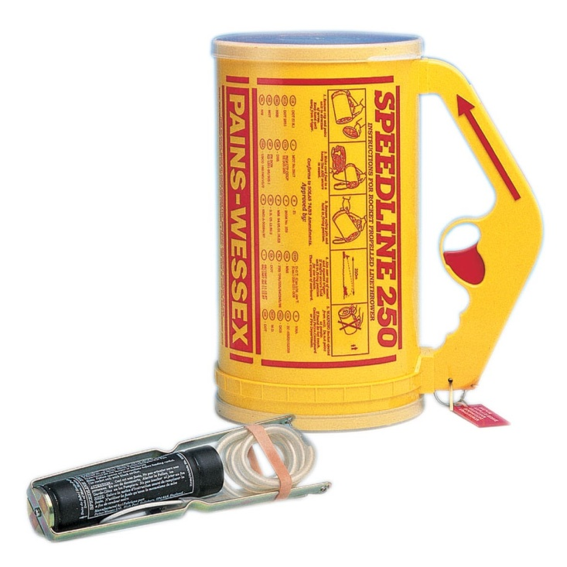
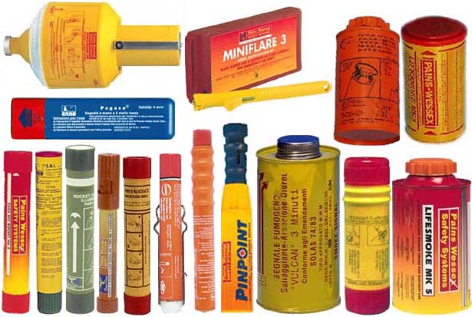
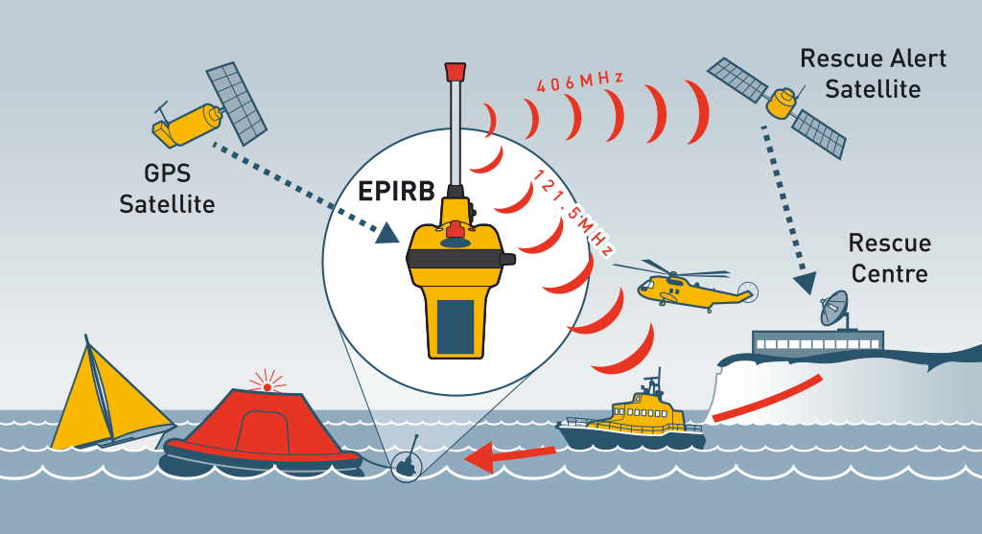
Lifesaving
  Subpart C Cont. - Lifesaving requirements for towing vessels
  Visual distress signals (day and night)
  Category 1 (float-free, automatically activated), 406 Mhz EPIRB based on area of operation
  Line throwing appliance with additional equipment for vessels operating in oceans and coastwise service.

Slide 20
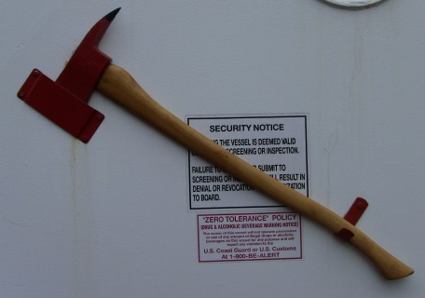
Fire Protection
Subpart A – General
Applicability
Subpart B - General requirements for towing vessels
Fire fighting equipment/systems CG approved
Alternative arrangements or equipment allowed
  Requires CG approval
Vessel maintained and operated to minimize fire hazards
Flammable/combustible products properly stowage
Firefighter’s outfits with SCBAs
  Vessels => 79 ft, oceans or coastwise routes, w/out fixed system
At least one (1) fire axe

Slide 21
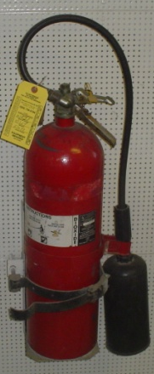
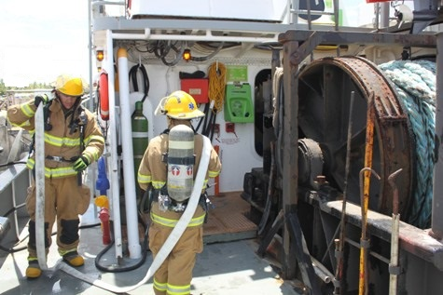
Fire Protection
Subpart B Cont. - General requirements for towing vessels
Minimum number of hand-portable fire extinguishers based on vessel length or gross tonnage
Extinguishers, extinguishing systems and fire detection systems inspected/tested at least once every 12 months
Monthly crew fire-fighting drills and instruction
New crewmember safety orientation

Slide 22
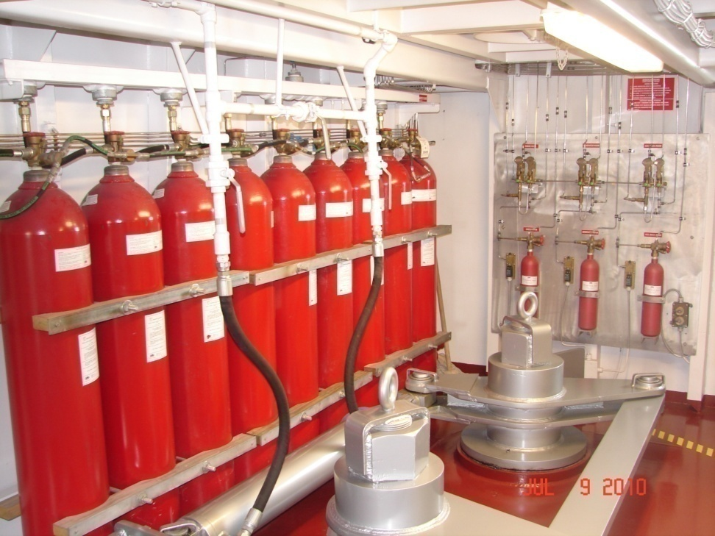
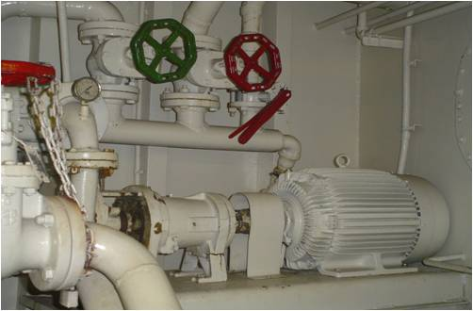
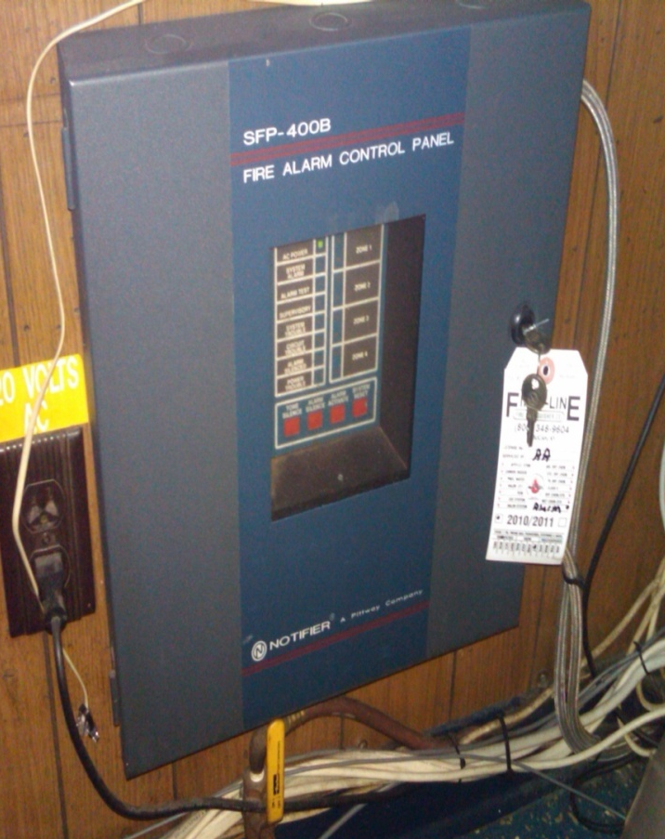
Fire Protection
Subpart C – Additional fire-extinguishing
equipment requirements
Semi-portable or/and fixed fire- extinguishing systems on certain vessels
Self-priming fire pump, either:
  Fixed pump, fire main, hoses and nozzles
  Portable pump hoses and nozzles
Fire detection system
Smoke detection in lounges and berthing spaces
Heat-detection in galley on new towing vessels

Slide 23
Machinery & Electrical – Existing Vsls
Acceptance of classed vessels
Control, Alarms, General Alarms and Monitoring – periodic readiness testing of alarms
Fuel System & Shutoffs-similar to existing Subchapter C requirements
Bilge Pumps & Dewatering-installed or portable
Pressure Vessels-working gauge and relief valve
Electrical Systems & Lighting – proper insulation and enclosures, marking of circuit breakers
Deferred (Pilothouse Alerter & Towing Machinery)

Slide 24
Machinery & Electrical – New Vsls
Acceptance of ABYC standards and Class Society Rules
ABS Rules < 90 meters required for many engineering systems, including pumps, piping, valves, fittings and pressure vessels
Electrical – prescriptive requirements if not classed
New vsls must comply with pilothouse alerter and readiness/testing requirements
Propulsion & Steering - For vsls that move tank barges carrying oil or hazardous materials in bulk, some redundancies required

Slide 25
Construction & Arrangement
General
  Class, Loadline, Design Standards
Structure
Stability & Watertight Integrity
Fire Protection
Emergency Escape
Ventilation
Crew Spaces
Rails and Guards
Visibility

Slide 26
Appeals, Equivalents& Special Consideration
Appeals (1.03-55)
  Survey – OCMI
  Audit – District Commander
  TVNCOE – COMDT (CG-CVC)
  OCMI or District Decision – OCMI, District, Commandant
Equivalents (136.115)
  Arrangement, fitting, applicance, apparatus, equipment, calculation, information or test – Request via OCMI
  Compliance with SOLAS provisions
  Alternative Compliance arrangements documented in TSMS
Special Consideration (136.120) - OCMI

Slide 27
Marine Safety Center Design Review
Marine Safety Center (MSC) Review for New and Existing Vessels
  Equivalents
  Alternate design or operational considerations
  Deviations from structural design standards
Design Verification for New Vessels
  Registered Professional Engineer (P.E.)
  Authorized Classification Society
  Coast Guard option
All major conversion determinations

Slide 28
MSC Requirements for Submissions
Authority | Cite | Description | Required Content
Equivalents | 46 CFR 136.115 | Alternative solutions to requirements or standards¹. | 1. Comparison analysis which clearly reflects the current standard and the suggested alternative including technical specifications. The analysis must demonstrate that the proposed alternative provides a level of safety equivalent to that intended by regulation. 2. Engineering analysis which includes risk-based and/or performance methodologies to justify the equivalency.
Alternate Design or Operational Consideration | 46 CFR 143.210 | Machinery or electrical systems of a novel design, unusual form, or special material (i.e., LNG-as-fuel, Li-ion battery propulsion, etc.) | 1. Systematic analysis, based on engineering principles, that the machinery or electrical system provides an equivalent level of safety as would be provided by meeting the existing rule/regulation.
Deviations from Structural Design Standards | 46 CFR 144.205(d) | Any use of a design standard not included in the regulation or incorporated by reference. | 1. Vessel design details. 2. Area of intended operation. 3. Detailed justification for deviation from required design standards.

Slide 29
Major Conversion
As defined in 46 CFR 136.110, a major conversion means a conversion of a vessel that meets any of the following:
  Substantially changes the dimension or carrying capacity of the vessel
  Changes the type of vessel
  Substantially prolongs the life of the vessel
  Otherwise changes the vessel in such a way that it becomes a new vessel
By policy, the Marine Safety Center is the Coast Guard’s authority for all major conversion determinations.

Slide 30
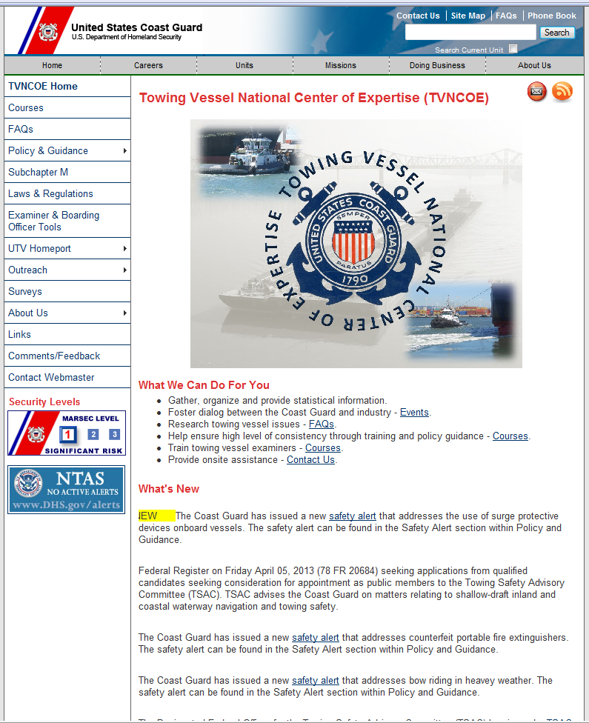
Website/E-Mail
Frequently Asked Questions
Policy /Guidance
Laws/Regulations
Useful Links
TVNCOE@uscg.mil
www.uscg.mil/tvncoe

Slide 31

TVNCOE List Server
Email notifications:
  Safety information
  Regulatory updates
  New Guidance
  Web site updates
  etc.
Information of interest to:
  Owners and operators of Coast Guard regulated towing vessels
  Coast Guard members who conduct towing vessel examinations and inspections
Free service
Easy to signup

Slide 32
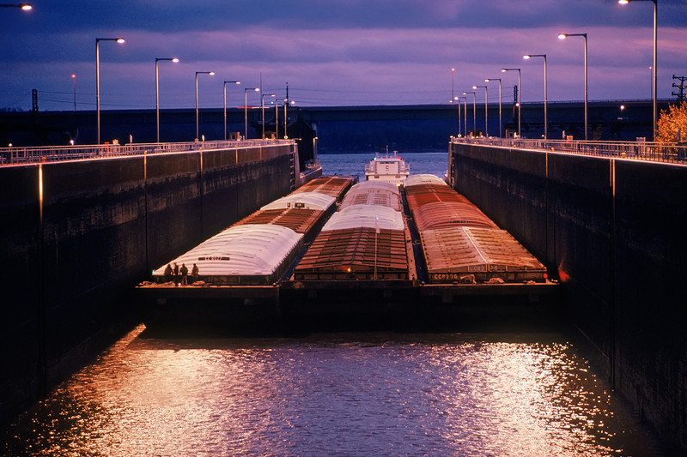
Questions?

